Slide 1
Hadoop Ecosystem
Pravin Y Pawar

Slide 2
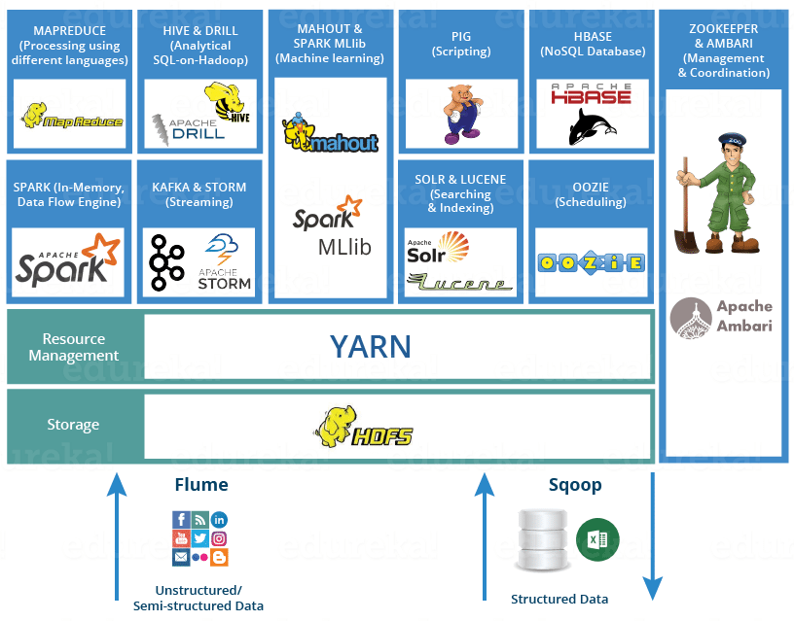
Hadoop Ecosystem
Image Source : Edureka

Slide 3
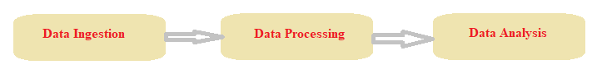
Ecosystem Components
Data Ingestion Components
Sqoop
Flume
Data Processing Components
MapReduce
Spark
Data Analysis Components
Pig
Hive
Impala

Slide 4

HDFS
Distributed Storage
Provides streaming access to the file system data as well as file permissions and authentications
Based on Google File System
Used to scale single cluster node to hundred and thousands of nodes
Uses commodity hardware to store data
Highly fault-tolerant
Stores files in the redundant fashion to allow for data recovery in case of failure

Slide 5

HBase
Stores data in HDFS
First non-batch component of Hadoop
Database on top of HDFS
Provides quick random access to the stored data
Low latency compared to HDFS
Non-relational , column-oriented database
Table can have thousands of rows and hundreds of columns
Row can have several column families
Column family can have several columns
Based on Google BigTable
Widely used in Facebook, Twitter, Yahoo etc

Slide 6
Difference between HDFS and HBase
HDFS | HBase
File system | Database
WORM – Write Once Read Multiple Times | Provides random read and write access
Based on Google File System | Based on Google BigTable
Supports only full / partial table scans | Supports random small range scan or table scan
Access to data only through MapReduce | Access to data through JAVA, Rest, Avro etc.
Suitable for batch analytics | Suitable for real-time analytics
High Latency operations | Low latency operations

Slide 7


Data Ingestion Components
Sqoop
SQL on Hadoop
Imports data form RDBMS like MySQL, Oracle to HDFS, Hbase, Hive
Exports data from HDFS to RDBMS
Uses Connector based architecture
Flume
Log aggregator – aggregates logs from different machines in HDFS
Developed by Cloudera
Designed for high volume ingestion of event-based data into Hadoop
Default destination is HDFS
Can write to HBase

Slide 8

Data Processing Components
MapReduce
Programming paradigm that allows distributed and parallel processing of huge datasets
Based on Google MapReduce
Gets the input from HDFS
Map Phase
Converts the input data (key-value format) into another key-value pairs
Reduce Phase
Intermediate outcomes produced by Map are inputs to the Reduce
Acts on the datasets to combine and reduce to a smaller set of tuples
Result is stored in the HDFS

Slide 9

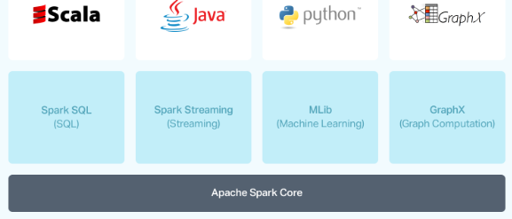
Data Processing Components (2)
Apache Spark
Programming as well as Computing model
Developed at UC Berkleys AmpLab
Provides in-memory computing for Hadoop
Workloads executes in memory rather than on disk
Owing to which its much faster
Potentially faster and more flexible alternative to MapReduce
Accesses data from HDFS but bypasses the MapReduce
Has following libraries
Spark SQL
Spark Streaming
Mlib
GraphX

Slide 10


Data Analysis Components
Pig
High level scripting language used with Hadoop
Serves as alternative for MapReduce
Pig Latin
SQL like scripting language
Scripts are translated to MapReduce jobs which are run on YARN and process data on cluster
Pig Runtime
Hive
Data warehouse built on top of Hadoop
Main tasks : summarization, querying and analysis
Queries are written in HiveQL – declarative SQL-like language
Converts SQL-style queries into MapReduce jobs which are run on Hadoop platform

Slide 11





Other components
Impala
High performance SQL engine runs on top of Hadoop
Ideal for interactive analytics
ZooKeeper
Coordination service for distributed applications
Oozie
Workflow scheduler system to manage Hadoop jobs
Mahout
Scalable machine learning and data mining library
Ambari
Web based tool for provisioning, managing and monitoring Hadoop applications

Slide 12
Thank You!
Reference :
Big Data and Analytics by Acharya, Chellappan
In our next session: HDFS

